Slide 1
COMP1860 Building our Digital World: Computer Systems & Architecture
S1.W2.L2: Two’s complement & Floating-Point Number Representations
Dr James Dyer

Slide 2


Slide 3
Book
This lecture covers the following sections of chapter 11 of Stallings Computer Architecture & Organisation:
  11.2 from Two’s complement representation to the end of chapter 11.5

Slide 4
Learning Outcomes
Explain the bit-level representations of fixed-length numbers.
Explain the bit-level representations of non-numeric data.
Translate numerical data from one format to another.

Slide 5
Overview
Two’s complement integers
Floating-point Representations

Slide 6
Two’s Complement Integers

Slide 7
Two’s Complement
Using 4 bits
Integer | 2’s complement
+7 | 0111
+6 | 0110
+5 | 0101
+4 | 0100
+3 | 0011
+2 | 0010
+1 | 0001
0 | 0000
Integer | 2’s complement
-1 | 1111
-2 | 1110
-3 | 1101
-4 | 1100
-5 | 1011
-6 | 1010
-7 | 1001
-8 | 1000

Slide 8
Benefits
One representation of zero
Arithmetic more uniform with signs
Negating is fairly easy
  Flip bits of representation
  Then add 1 to least significant bit (rightmost)
Example
  3 = 0011 and we calculate −3 as follows
  Bitwise complement 1100
  Add 1 to least significant bit (LSB - the most right one) 1101

Slide 9
Exercise
Compute −5 in twos complement notation (using 5 bits).

Slide 10
Geometric depiction of 2’s complement

Slide 11
Negation: Special Case 1
0 = 0000
Bitwise complement 1111
Add 1 to LSB 1 0000
Ignore overflow: −0 = 0000 = 0

Slide 12
Negation: Special Case 2
−8 = 1000
  Bitwise complement 0111
  Add 1 to LSB 1000
  wrong! −(−8) = 1000 = −8
But there is no representation of +8 so what did we expect?!?!
Strategy: monitor the sign bit - the left most bit is the most significant bit (MSB) - it should change during negation

Slide 13
Overflow
Consider adding 6 to 7 in 4-bit 2’s complement
  6 is 0110, 7 is 0111
  Sum by binary addition is 1101
  This is -3!
If we consider the geometric representation
  Start at 6 and count 7 steps clockwise (addition)
  We end up at -3
Overflow rule:
  If two numbers are added, and they are both positive or both negative, then overflow occurs if and only if the result has the opposite sign
  MSB gives sign: 0 positive integer, 1 negative integer

Slide 14
Range of Numbers
4-bit 2s complement
  +7 = 0111 = 2³ − 1
  −8 = 1000 = −2³
8-bit 2s complement
  +127 = 0111 1111 = 2⁷ − 1
  −128 = 1000 0000 = −2⁷
16-bit 2s complement
  +32767 = 0111 1111 1111 1111 = 2¹⁵ − 1
  −32768 = 1000 0000 0000 0000 = −2¹⁵

Slide 15
Conversion between lengths
Positive numbers pack with leading zeros
  +18 = 0001 0010 (8-bit)
  +18 = 0000 0000 0001 0010 (16-bit).
Negative numbers pack with leading ones
  −18 = 1110 1110 (8-bit)
  −18 = 1111 1111 1110 1110 (16-bit).
In general, pack with MSB.

Slide 16
Addition and Subtraction
Addition
  Normal binary addition
  If either both numbers are positive or both negative, then a change in the sign bit means overflow and the result should not be used
Subtraction
  a − b = a + (−b)
  Take the complement and add

Slide 17
Exercise
Compute the 5-bit two’s complement of 5 and 7.
Compute the 5-bit two’s complement of −5 and −7.
Using their two’s complement, compute 5 + 7, 5 − 7, −5 + 7, 5 − (−7).
How would two’s complement multiplication work?

Slide 18
Floating-Point Representations

Slide 19
Scientific Notation
Also called exponential notation
  12345 = 123.45 × 100 = 1.2345 × 10⁴
4 specifications required for a number
Sign (+ in example)
Mantissa (1.2345)
Sign of the exponent (+ in 10⁴)
Magnitude of the exponent (4 in 10⁴)
Plus
Base of the exponent (10)
Location of the decimal point (or other base) radix point

Slide 20

Example
Sign of the exponent
Sign of the mantissa
-3.579$×$10⁻⁶
Exponent
Location of the decimal point
Mantissa
Base

Slide 21
Exercise
Identify the sign and magnitude in the mantissa and exponent in the following two binary examples (base in binary):
  1.01001 × 10⁻¹⁰¹
  −1.1101 × 10¹⁰⁰¹

Slide 22
Precision
The number of digits in the mantissa is the precision of the number
Example:
  1.2345 × 10⁴ is 5 digits of precision

Slide 23
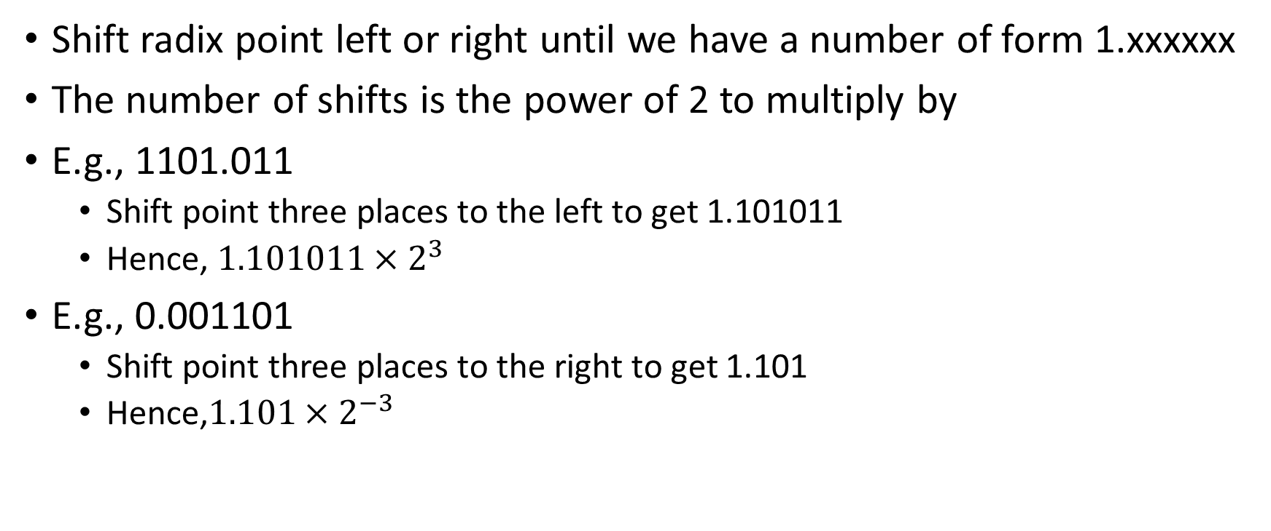
Normalising Binary Fractions
Shift radix point left or right until we have a number of form 1.xxxxxx
The number of shifts is the power of 2 to multiply by
E.g., 1101.011
  Shift point three places to the left to get 1.101011
  Hence, $1.101011×2^{3}$
E.g., 0.001101
  Shift point three places to the right to get 1.101
  Hence,$1.101×2^{−3}$

Slide 24
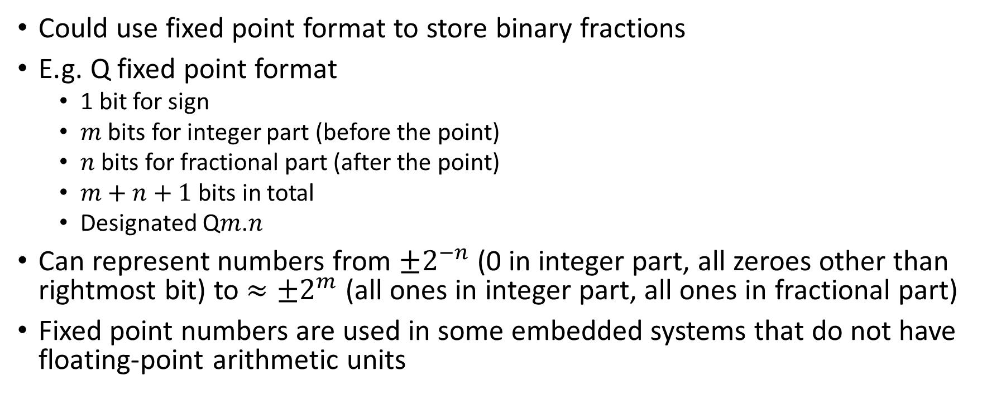
Fixed Point
Could use fixed point format to store binary fractions
E.g. Q fixed point format
  1 bit for sign
  $m$ bits for integer part (before the point)
  $n$ bits for fractional part (after the point)
  $m+n+1$ bits in total
  Designated Q$m$.$n$
Can represent numbers from $±2^{−n}$ (0 in integer part, all zeroes other than rightmost bit) to $≈±2^{m}$ (all ones in integer part, all ones in fractional part)
Fixed point numbers are used in some embedded systems that do not have floating-point arithmetic units

Slide 25
Fixed Point Example
3.25 in Q3.4 format
3 is 011 in 3-bit binary
0.25 is 0100 as a 4-bit binary fraction
Number is positive so sign bit is 0
Hence, 3.25 is represented as 00110100 in fixed point format.

Slide 26
Floating Point Formats
Uses normalised binary fraction
The format specifies which bits correspond to
  The sign of the mantissa
  The exponent
  The mantissa

Slide 27
Standard 32-bit Floating-Point Format
A common floating-point binary format:
  32 bits
  The first bit is the sign bit, 0 for positive
  The next 8 bits represent the exponent, in 127-bias notation
  This leaves 23 bits for the mantissa.
This format will be able to represent numbers in the range ≈ 10⁻³⁸ to 10³⁸ with approximately 7 decimal digits of precision.
This is the format specified in IEEE 754 for single precision floating-point numbers
  IEEE 754 specifies other formats which use more bits for greater precision

Slide 28
127 bias notation
Exponent is stored in biased notation
Bias 127 means that we use the numbers 0 to 255 in order to represent the numbers −127 to +128.
In order to calculate the biased notation, we add 127 to the true exponent which we wish to store.
Example
In IEEE 754 exponents of 0 and 255 represent special values so the actual range is −126 to +127
Representation | 0 | 126 | 127 | 255
Exponent being raised | -127 | -1 | 0 | 128

Slide 29
Normalisation
Floating point numbers are usually normalised.
i.e., the exponent is adjusted so that the leading bit (MSB) of mantissa is 1
Since it is always 1 there is no need to store it.
(c.f. Scientific notation where numbers are normalised to give a single digit before the decimal point e.g. 3.123 × 10³)

Slide 30
Exercise
Convert the following binary number to IEEE754 standard 32-bit floating point format:
−1.1101 × 10¹⁰⁰¹ (mantissa, base and exponent in binary)
Answer:
  Sign: negative, Sign bit: 1
  Exponent: 1001, 127-bias notation:
    9₁₀ → 136_{127-bias,10} → 10001000_{127-bias,2}
  Mantissa: 1.1101, Normalised: 1101 (postpended with zeroes to make 23 bits)
  1100 0100 0110 1000 0000 0000 0000 0000.

Slide 31
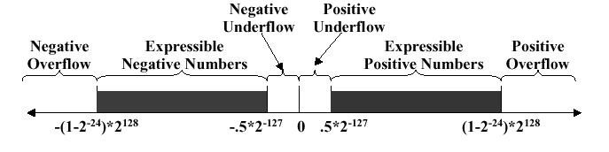
Overflow and underflow
Possible for the number to be too large or too small for representation.

Slide 32
Floating Point Addition & Subtraction
Exponent and mantissa treated separately
Process:
  Exponents of numbers must agree
    Align radix points
    Least significant digits may be lost
  Add and subtract aligned mantissa
  Result may need to be renormalised

Slide 33
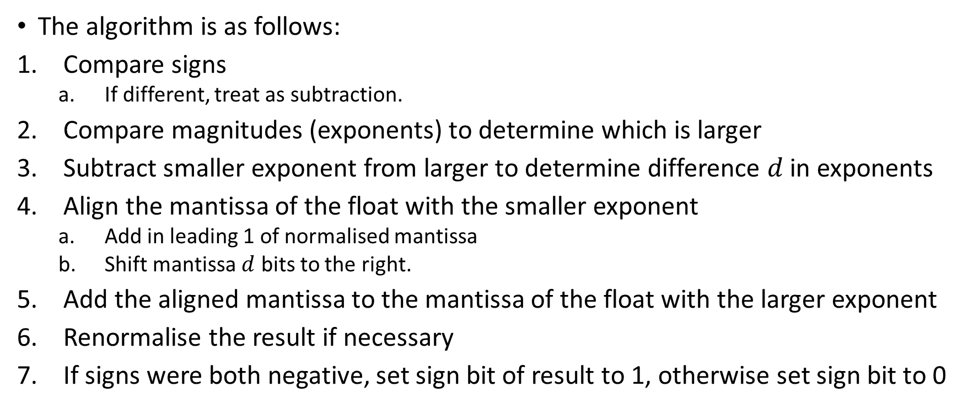
Floating Point Addition
The algorithm is as follows:
Compare signs
  If different, treat as subtraction.
Compare magnitudes (exponents) to determine which is larger
Subtract smaller exponent from larger to determine difference $d$ in exponents
Align the mantissa of the float with the smaller exponent
  Add in leading 1 of normalised mantissa
  Shift mantissa $d$ bits to the right.
Add the aligned mantissa to the mantissa of the float with the larger exponent
Renormalise the result if necessary
If signs were both negative, set sign bit of result to 1, otherwise set sign bit to 0

Slide 34
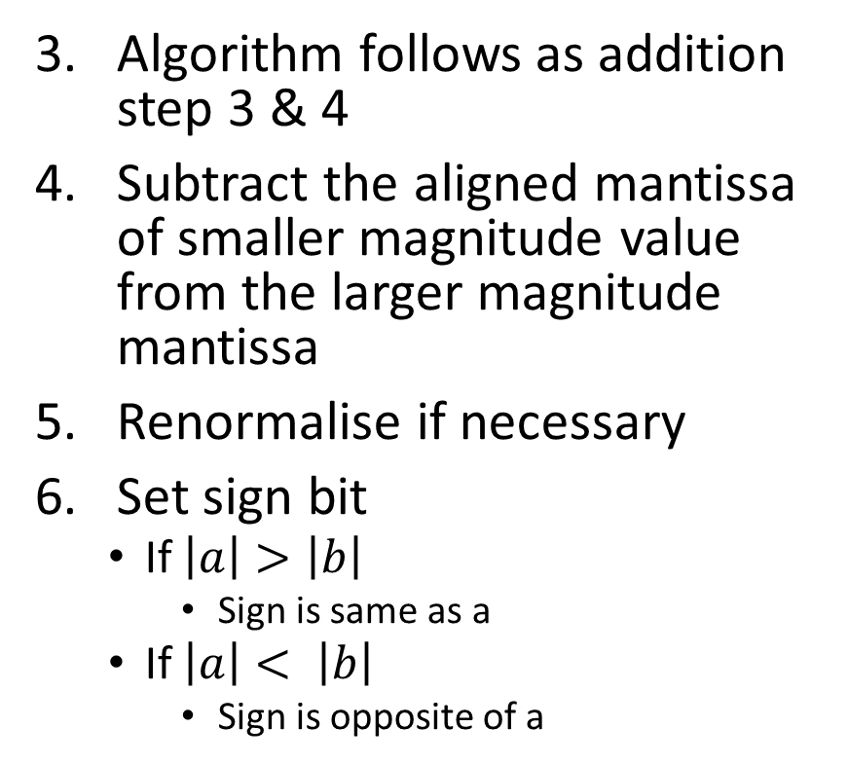
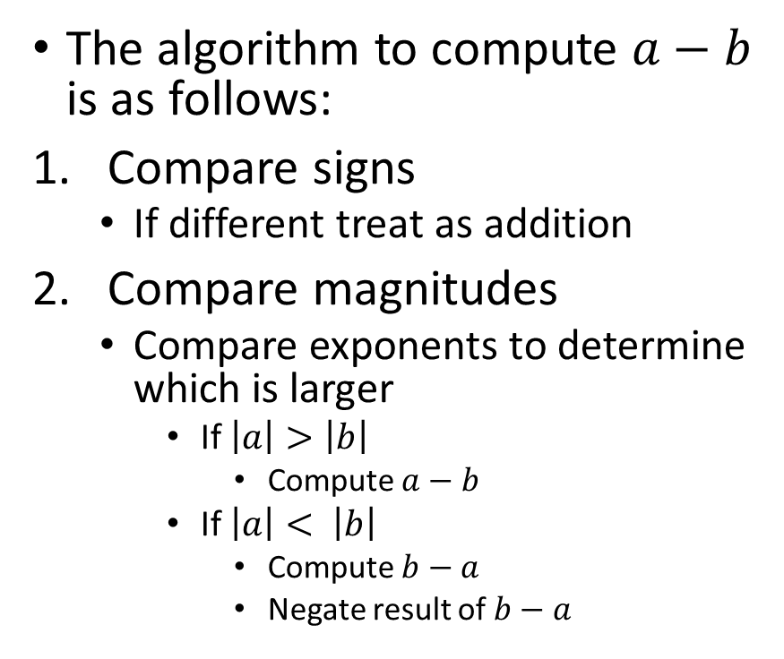
Floating Point Subtraction
The algorithm to compute $a−b$ is as follows:
Compare signs
  If different treat as addition
Compare magnitudes
  Compare exponents to determine which is larger
    If $\left|a\right|>\left|b\right|$
      Compute $a−b$
    If $\left|a\right|< \left|b\right|$
      Compute $b−a$
      Negate result of $b−a$
Algorithm follows as addition step 3 & 4
Subtract the aligned mantissa of smaller magnitude value from the larger magnitude mantissa
Renormalise if necessary
Set sign bit
  If $\left|a\right|>\left|b\right|$
    Sign is same as a
  If $\left|a\right|< \left|b\right|$
    Sign is opposite of a

Slide 35
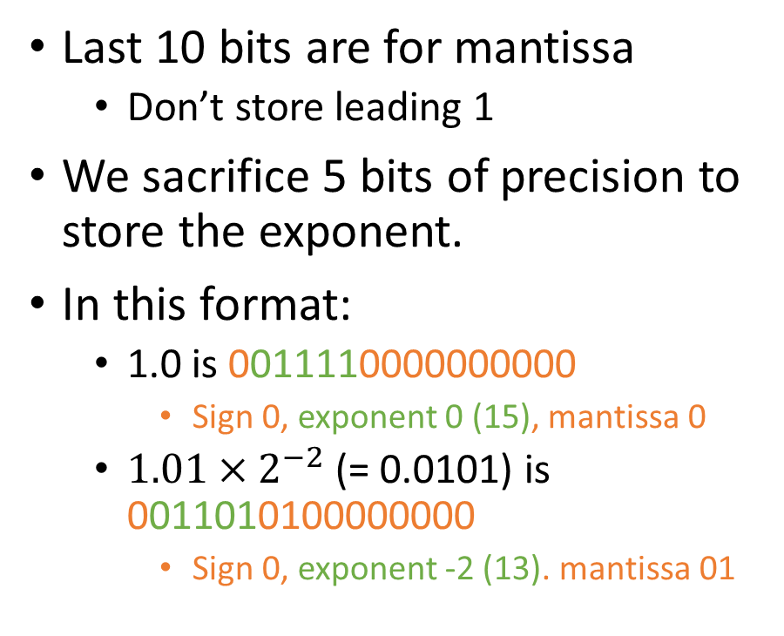
Half-precision format (16-bit)
16-bit format
  SEEEEEMMMMMMMMMM
First bit is the sign bit
Next 5 bits used for exponent
  00001 (1) is −14 (min exponent)
  01111 (15) is exponent 0
  11110 (30)is +15 (max exponent)
Last 10 bits are for mantissa
  Don’t store leading 1
We sacrifice 5 bits of precision to store the exponent.
In this format:
  1.0 is 0011110000000000
    Sign 0, exponent 0 (15), mantissa 0
  $1.01×2^{−2}$ (= 0.0101) is 0011010100000000
    Sign 0, exponent -2 (13). mantissa 01

Slide 36
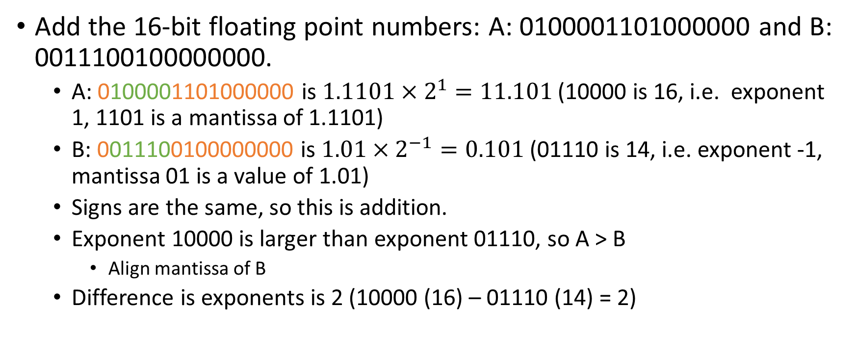
Example: Addition
Add the 16-bit floating point numbers: A: 0100001101000000 and B: 0011100100000000.
  A: 0100001101000000 is $1.1101×2^{1}=11.101$ (10000 is 16, i.e. exponent 1, 1101 is a mantissa of 1.1101)
  B: 0011100100000000 is $1.01×2^{−1}=0.101$ (01110 is 14, i.e. exponent -1, mantissa 01 is a value of 1.01)
  Signs are the same, so this is addition.
  Exponent 10000 is larger than exponent 01110, so A > B
    Align mantissa of B
  Difference is exponents is 2 (10000 (16) – 01110 (14) = 2)

Slide 37
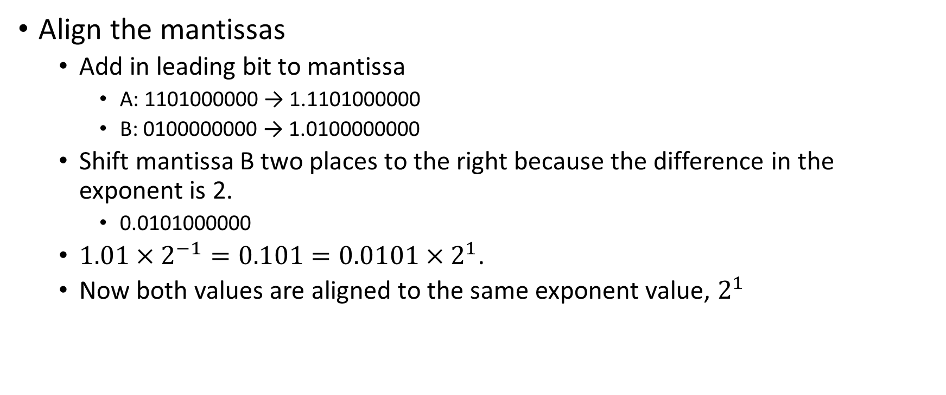
Example: Addition
Align the mantissas
  Add in leading bit to mantissa
    A: 1101000000 → 1.1101000000
    B: 0100000000 → 1.0100000000
  Shift mantissa B two places to the right because the difference in the exponent is 2.
    0.0101000000
  $1.01×2^{−1}=0.101=0.0101×2^{1}$.
  Now both values are aligned to the same exponent value, $2^{1}$

Slide 38
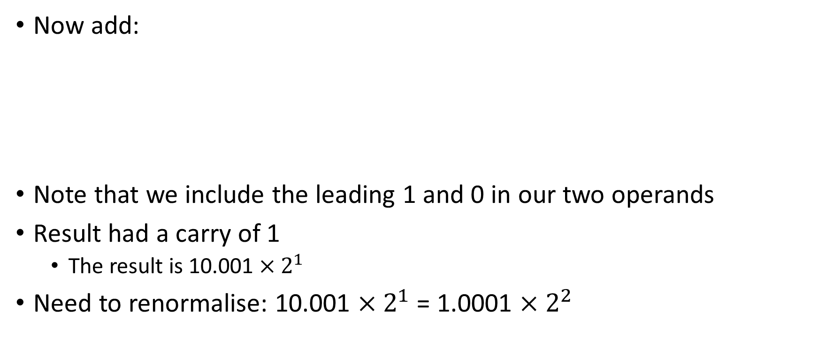
Example: Addition
Now add:
Note that we include the leading 1 and 0 in our two operands
Result had a carry of 1
  The result is 10.001 $×2^{1}$
Need to renormalise: 10.001 $×2^{1}$= 1.0001 $×2^{2}$
₁ | ₁ |  | ₁ |  | ₁
 | 1 | . | 1 | 1 | 0 | 1 | 0 | 0 | 0 | 0 | 0 | 0
+ | 0 | . | 0 | 1 | 0 | 1 | 0 | 0 | 0 | 0 | 0 | 0
1 | 0 | . | 0 | 0 | 1 | 0 | 0 | 0 | 0 | 0 | 0 | 0

Slide 39
Example: Addition
A & B both have sign bit 0, so result sign bit is 0
Exponent is 2 = 10001 (17)
Normalised mantissa of result is 0001000000
Representation: 0100010001000000

Slide 40
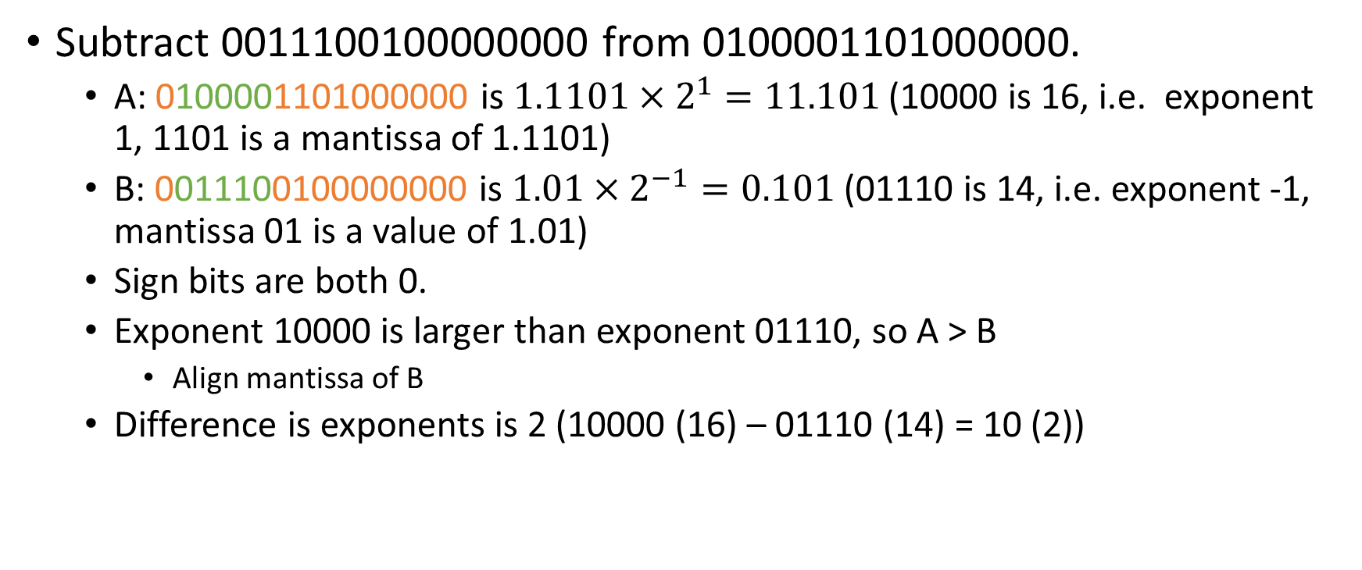
Example: Subtraction
Subtract 0011100100000000 from 0100001101000000.
  A: 0100001101000000 is $1.1101×2^{1}=11.101$ (10000 is 16, i.e. exponent 1, 1101 is a mantissa of 1.1101)
  B: 0011100100000000 is $1.01×2^{−1}=0.101$ (01110 is 14, i.e. exponent -1, mantissa 01 is a value of 1.01)
  Sign bits are both 0.
  Exponent 10000 is larger than exponent 01110, so A > B
    Align mantissa of B
  Difference is exponents is 2 (10000 (16) – 01110 (14) = 10 (2))

Slide 41
Example: Subtraction
Align the mantissas
  Add in leading bit to mantissa
    A: 1101000000 → 1.1101000000
    B: 0100000000 → 1.0100000000
  Shift mantissa B two places to the right because the difference in the exponent is 2.
    0.0101000000
  $1.01×2^{−1}=0.101=0.0101×2^{1}$.
  Now both values are aligned to the same exponent value, $2^{1}$

Slide 42
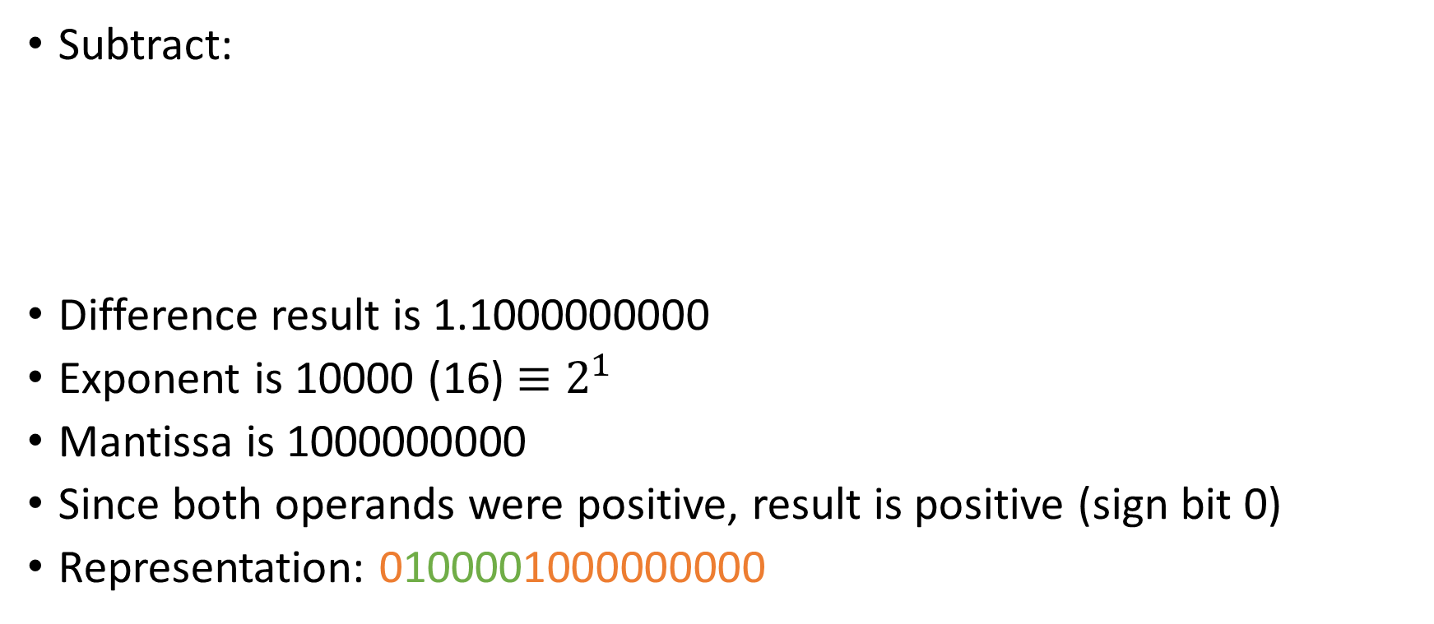
Example: Subtraction
Subtract:
Difference result is 1.1000000000
Exponent is 10000 (16) $≡2^{1}$
Mantissa is 1000000000
Since both operands were positive, result is positive (sign bit 0)
Representation: 0100001000000000
 | 1 | . | 1 | 1 | 0 | 1 | 0 | 0 | 0 | 0 | 0 | 0
- | 0 | . | 0 | 1 | 0 | 1 | 0 | 0 | 0 | 0 | 0 | 0
 | 1 | . | 1 | 0 | 0 | 0 | 0 | 0 | 0 | 0 | 0 | 0

Slide 43
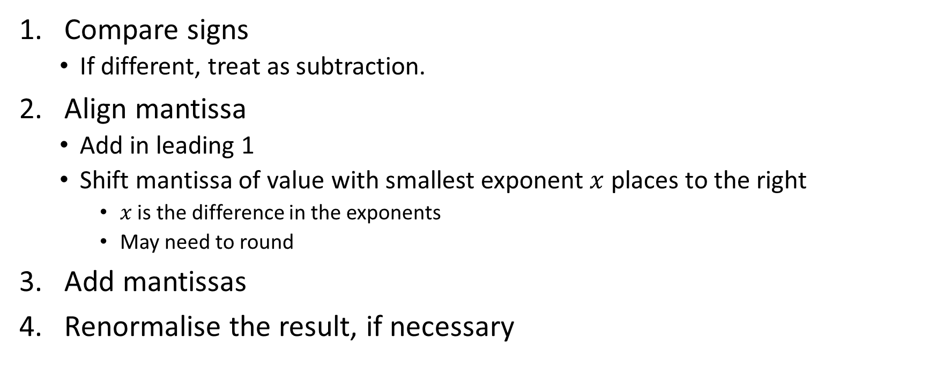
Addition Summary
Compare signs
  If different, treat as subtraction.
Align mantissa
  Add in leading 1
  Shift mantissa of value with smallest exponent $x$ places to the right
    $x$ is the difference in the exponents
    May need to round
Add mantissas
Renormalise the result, if necessary

Slide 44
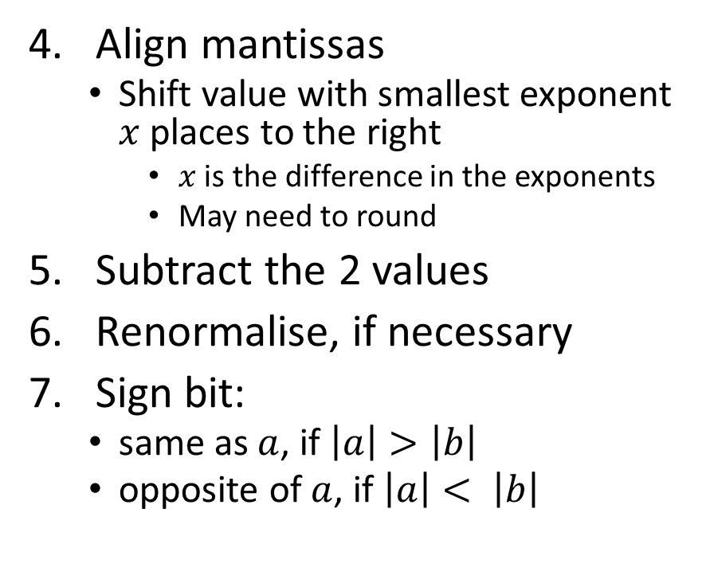
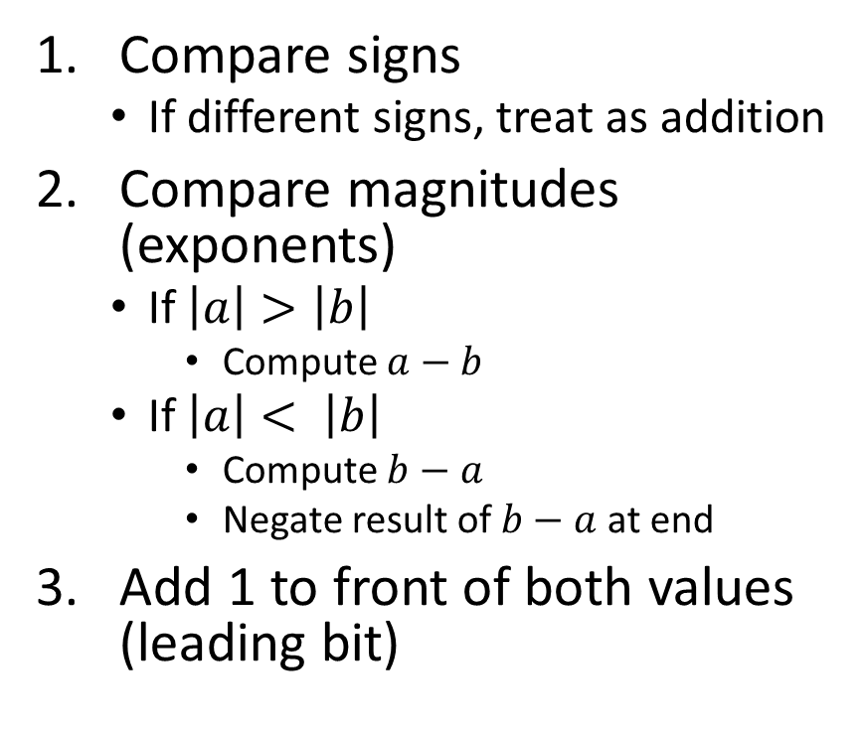
Subtraction Summary
Compare signs
  If different signs, treat as addition
Compare magnitudes (exponents)
  If $\left|a\right|>\left|b\right|$
    Compute $a−b$
  If $\left|a\right|< \left|b\right|$
    Compute $b−a$
    Negate result of $b−a$ at end
Add 1 to front of both values (leading bit)
Align mantissas
  Shift value with smallest exponent $x$ places to the right
    $x$ is the difference in the exponents
    May need to round
Subtract the 2 values
Renormalise, if necessary
Sign bit:
  same as $a$, if $\left|a\right|>\left|b\right|$
  opposite of $a$, if $\left|a\right|< \left|b\right|$

Slide 45
Exercise
Add the following half precision floating point numbers:
0100011111100000 (1.11111 × 2²)
0011001000000000 (1.1 × 2⁻³ )
Give the result in half precision format

Slide 46
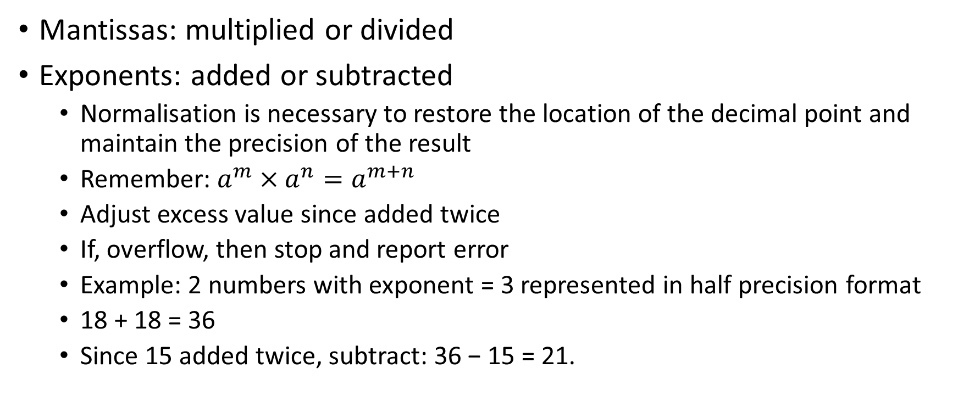
Multiplication and division
Mantissas: multiplied or divided
Exponents: added or subtracted
  Normalisation is necessary to restore the location of the decimal point and maintain the precision of the result
  Remember: $a^{m}×a^{n}=a^{m+n}$
  Adjust excess value since added twice
  If, overflow, then stop and report error
  Example: 2 numbers with exponent = 3 represented in half precision format
  18 + 18 = 36
  Since 15 added twice, subtract: 36 − 15 = 21.

Slide 47
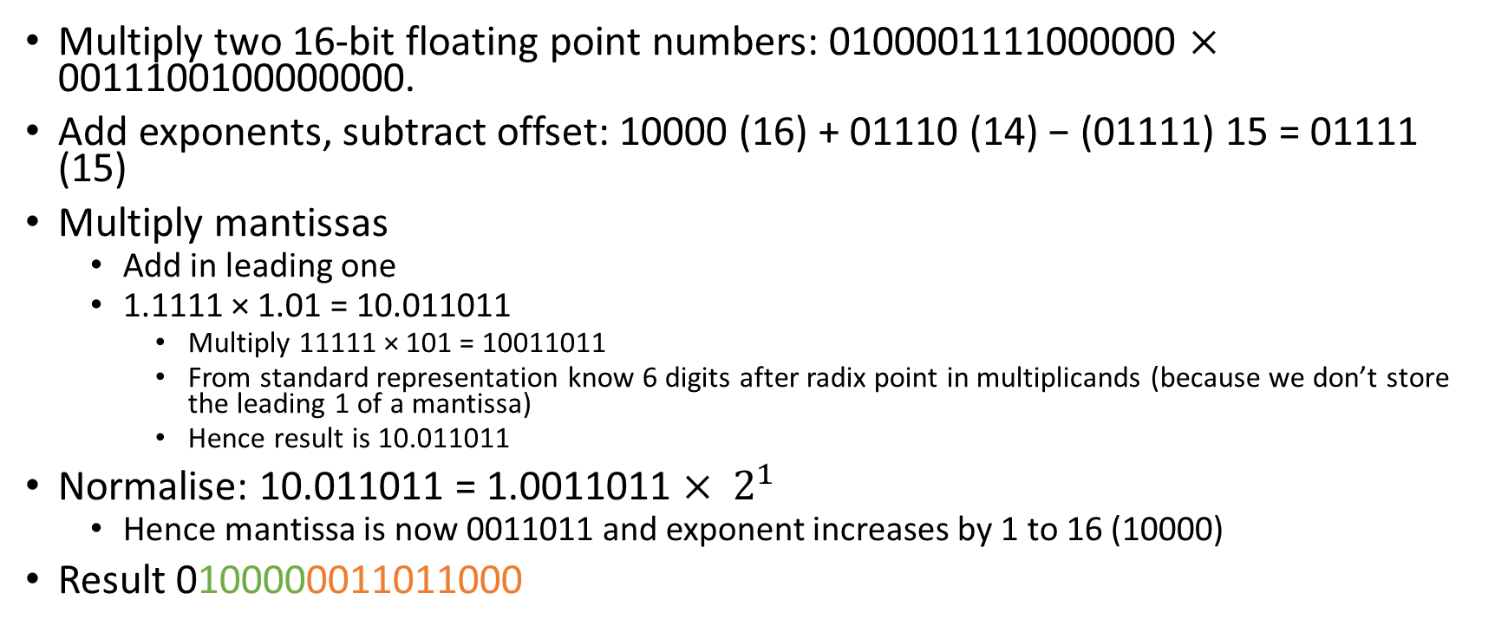
Multiplication Example
Multiply two 16-bit floating point numbers: 0100001111000000 $×$ 0011100100000000.
Add exponents, subtract offset: 10000 (16) + 01110 (14) − (01111) 15 = 01111 (15)
Multiply mantissas
  Add in leading one
  1.1111 × 1.01 = 10.011011
    Multiply 11111 × 101 = 10011011
    From standard representation know 6 digits after radix point in multiplicands (because we don’t store the leading 1 of a mantissa)
    Hence result is 10.011011
Normalise: 10.011011 = 1.0011011 $× 2^{1}$
  Hence mantissa is now 0011011 and exponent increases by 1 to 16 (10000)
Result 0100000011011000

Slide 48
IEEE Standard 754
Standard was developed to facilitate the portability of programs from one processor to another and to encourage the development of sophisticated, numerically oriented programs
Standard has been widely adopted and is used on virtually all contemporary processors and arithmetic coprocessors
IEEE 754-2008 covers both binary and decimal floating-point representations

Slide 49
IEEE 754: Special Values
 | Sign | Biased Exponent | Fraction | Value
positive zero | 0 | 0 | 0 | 0
negative zero | 1 | 0 | 0 | –0
plus infinity | 0 | all 1s | 0 | ∞
minus infinity | 1 | all 1s | 0 | –∞
quiet NaN | 0 or 1 | all 1s | ≠ 0; first bit = 1 | qNaN
signaling NaN | 0 or 1 | all 1s | ≠ 0; first bit = 0 | sNaN

Slide 50
IEEE 754 Decimal Representations
We saw in the previous lecture how binary fractions can only approximate some decimal fractions
  Can result in rounding errors
For some applications better to use decimal fractions
IEEE 754 specifies decimal formats (decimal32, decimal64, etc.) as well
  Uses BCD or densely packed decimal (DPD) to represent significand (mantissa)
  DPD is a more space efficient format

Slide 51
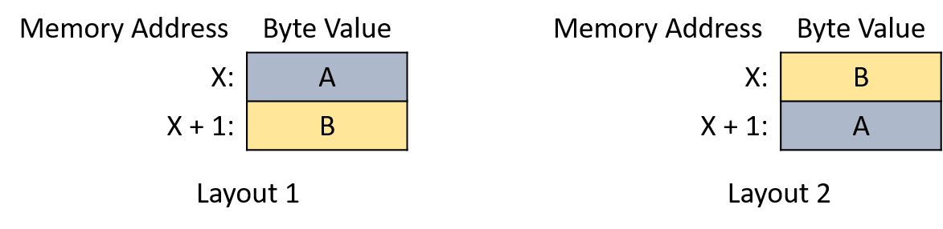
Byte Order
When a system stores a multibyte value how does it store it?
  E.g. 32-bit 2’s complement number is 4 bytes long
The endianness is the order in which each byte of the integer will be stored

Slide 52
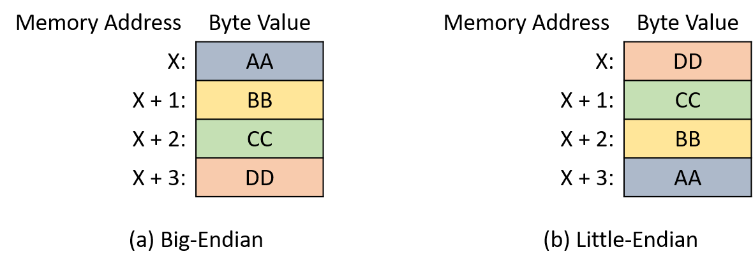
Example: Endianness
Integer 1430532899 (AABBCCDD in hexadecimal)

Slide 53
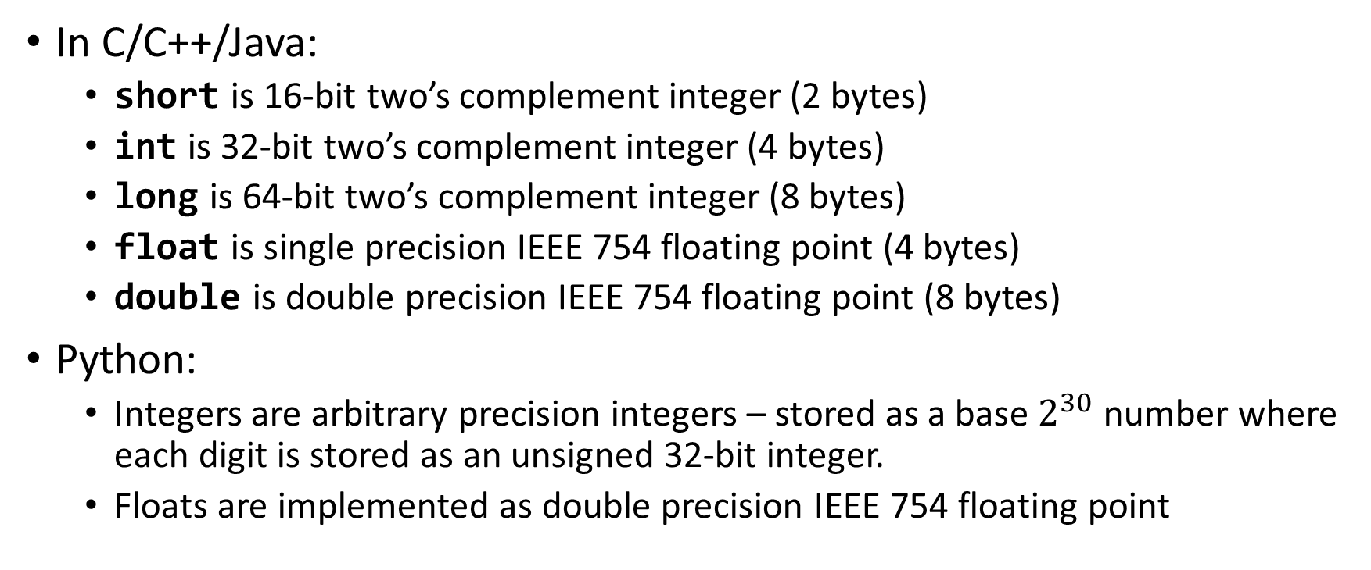
Numeric Data Representations in Programming Languages
In C/C++/Java:
  short is 16-bit two’s complement integer (2 bytes)
  int is 32-bit two’s complement integer (4 bytes)
  long is 64-bit two’s complement integer (8 bytes)
  float is single precision IEEE 754 floating point (4 bytes)
  double is double precision IEEE 754 floating point (8 bytes)
Python:
  Integers are arbitrary precision integers – stored as a base $2^{30}$ number where each digit is stored as an unsigned 32-bit integer.
  Floats are implemented as double precision IEEE 754 floating point

Slide 54
Summary
Two’s complement integers
Floating-Point Representations

